Slide 1
VLSI Architecture Design
Project Presentation
An SRAM-Based Multibit In-Memory
Matrix-Vector Multiplier With a Precision That
Scales Linearly in Area, Time, and Power

Slide 2
Table of contents
01
04
02
05
03
06
Introduction
Results
Proposed IMCU Circuit
Conclusion
Implementation
Future work and References

Slide 3
01
Introduction

Slide 4
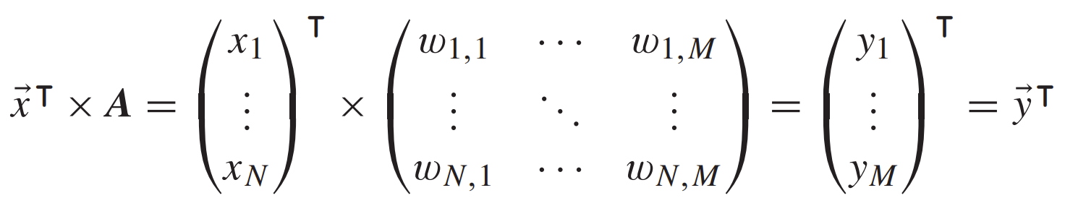
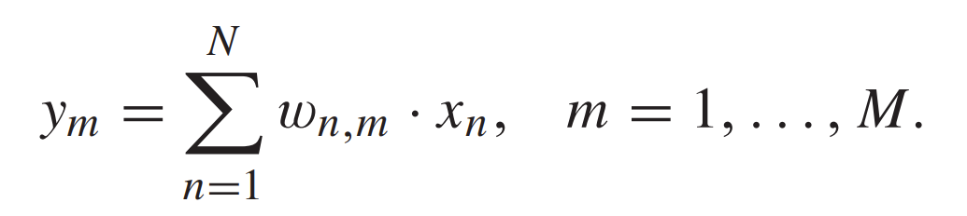
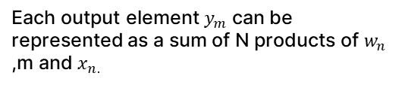
Introduction
The selected paper describes a novel architecture of an In-Memory Compute Unit (IMCU) for MAC (Multiply-Accumulate) operations.
The IMCU unit allows the analog computation of matrix-vector multiplication which are the base of all machine and deep learning applications.
The described MAC operations can be written in equation as follows:
Each output element $y_{m}$ can be represented as a sum of N products of $w_{n}$ ,m and $x_{n.}$

Slide 5
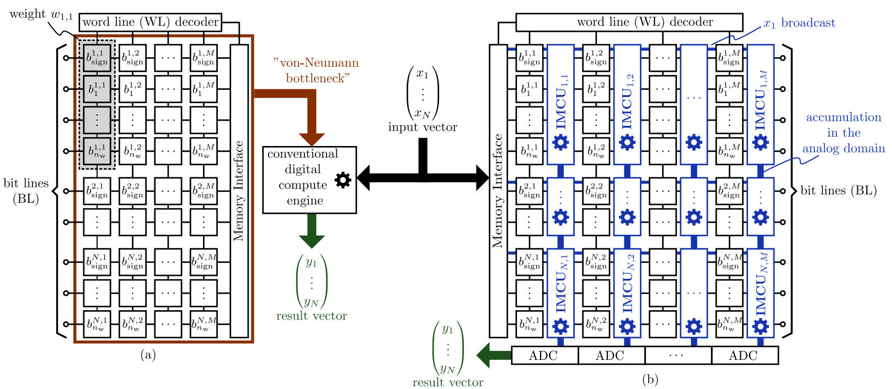
Introduction
The conventional Von-Neumann architecture incurs time and energy costs when performing MAC operations by transferring matrix elements stored in memory units to a physically separated digital computation unit (ALU), creating a performance bottleneck.
Thus, through the user of IMCUs, all computational primitives required are executed within the memory subsystem resulting in energy efficient and faster computation.
The representation below shows the major differences between the two architectures.
Figure 1: a) Conventional Von-Neumann Architecture. b) In-Memory Computation based Architecture with IMC units

Slide 6
02
Proposed IMCU CIRCUIT

Slide 7
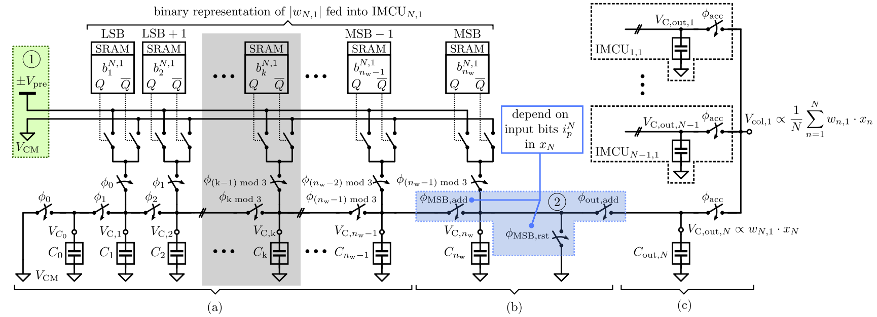
Proposed IMCU Circuit
Figure 2: a) DAC Conversion b) Analog Multiplication c) Analog Accumulation

Slide 8
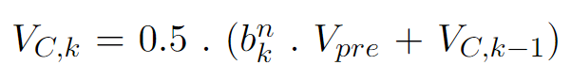
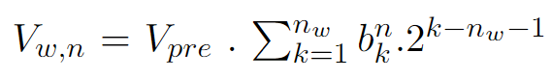
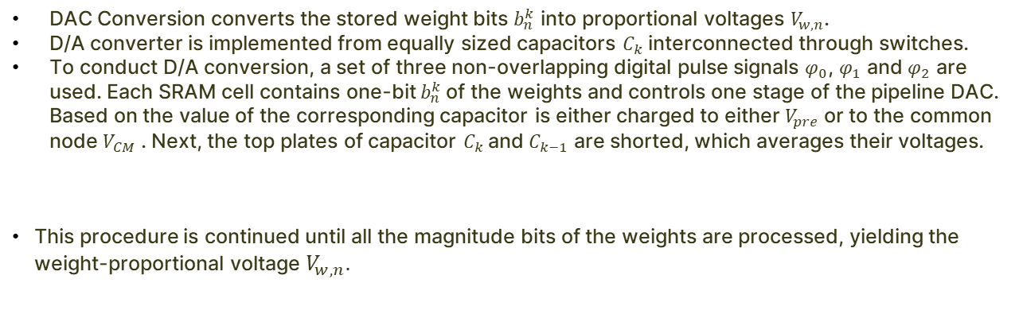
DAC Conversion
DAC Conversion converts the stored weight bits $b_{n}^{k}$ into proportional voltages $V_{w,n}$.
D/A converter is implemented from equally sized capacitors $C_{k}$ interconnected through switches.
To conduct D/A conversion, a set of three non-overlapping digital pulse signals $φ_{0}$, $φ_{1}$ and $φ_{2}$ are used. Each SRAM cell contains one-bit $b_{n}^{k}$of the weights and controls one stage of the pipeline DAC. Based on the value of the corresponding capacitor is either charged to either $V_{pre}$ or to the common node $V_{CM}$ . Next, the top plates of capacitor $C_{k}$and $C_{k−1}$ are shorted, which averages their voltages.
This procedure is continued until all the magnitude bits of the weights are processed, yielding the weight-proportional voltage $V_{w,n}$.

Slide 9
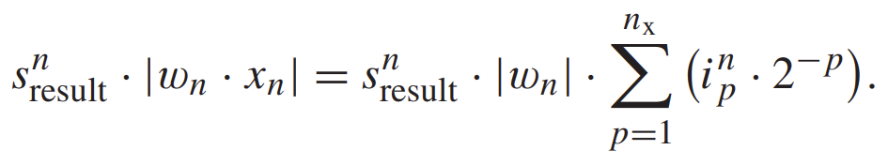
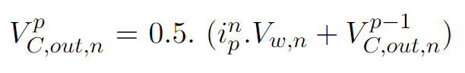
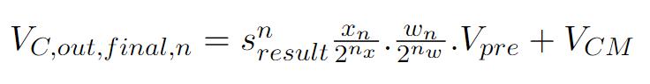
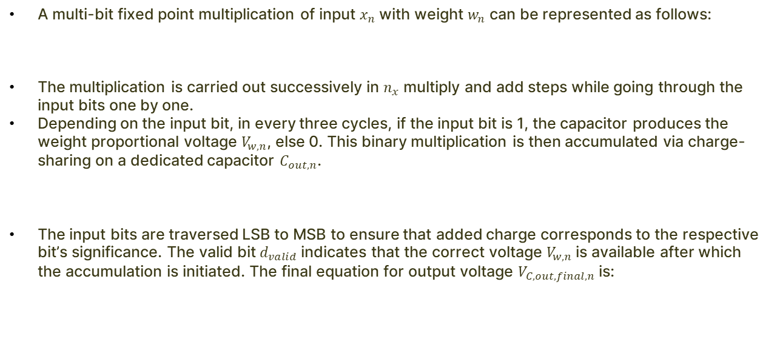
Analog Multiplication
A multi-bit fixed point multiplication of input $x_{n}$ with weight $w_{n}$ can be represented as follows:
The multiplication is carried out successively in $n_{x}$ multiply and add steps while going through the input bits one by one.
Depending on the input bit, in every three cycles, if the input bit is 1, the capacitor produces the weight proportional voltage $V_{w,n}$, else 0. This binary multiplication is then accumulated via charge-sharing on a dedicated capacitor $C_{out,n}$.
The input bits are traversed LSB to MSB to ensure that added charge corresponds to the respective bit’s significance. The valid bit $d_{valid}$indicates that the correct voltage $V_{w,n}$is available after which the accumulation is initiated. The final equation for output voltage $V_{C,out,final,n}$is:

Slide 10
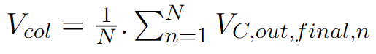
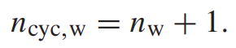
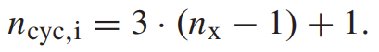
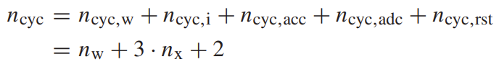
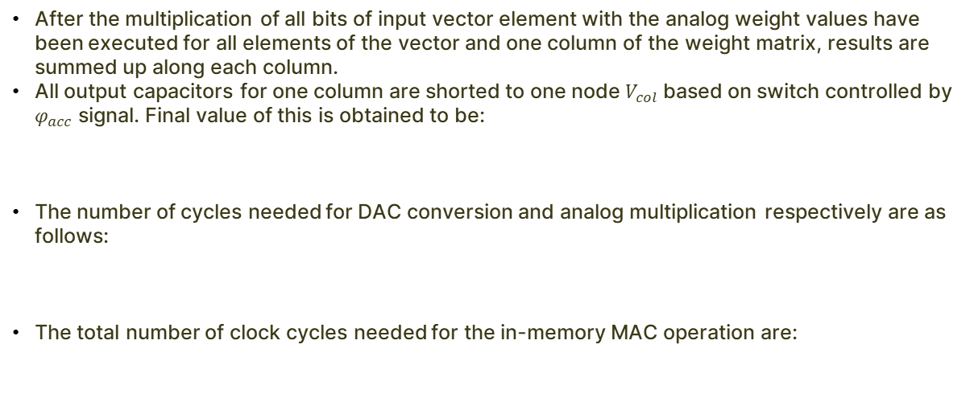
Analog Accumulator
After the multiplication of all bits of input vector element with the analog weight values have been executed for all elements of the vector and one column of the weight matrix, results are summed up along each column.
All output capacitors for one column are shorted to one node $V_{col}$ based on switch controlled by $φ_{acc}$ signal. Final value of this is obtained to be:
The number of cycles needed for DAC conversion and analog multiplication respectively are as follows:
The total number of clock cycles needed for the in-memory MAC operation are:

Slide 11
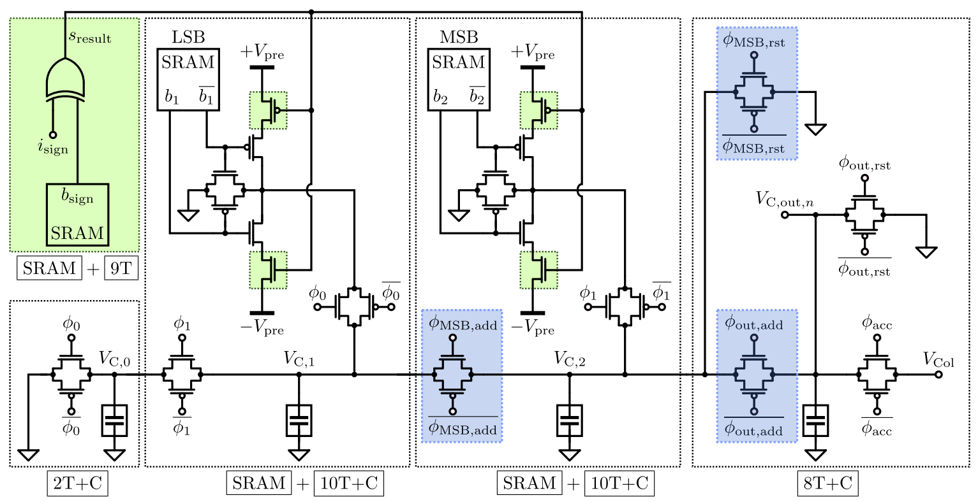
3-Bit IMCU
Figure : Given circuit of a 3-bit signed IMCU

Slide 12
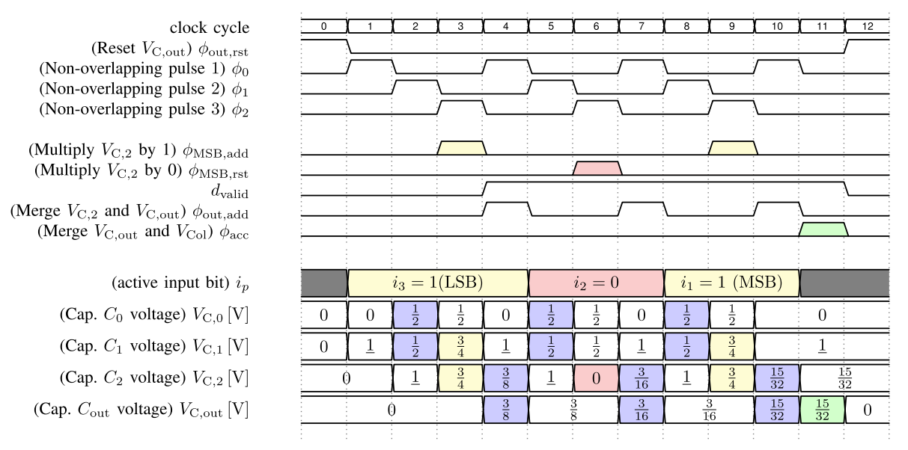
3-Bit IMCU
Figure : All signals for inputs and outputs of IMCU

Slide 13
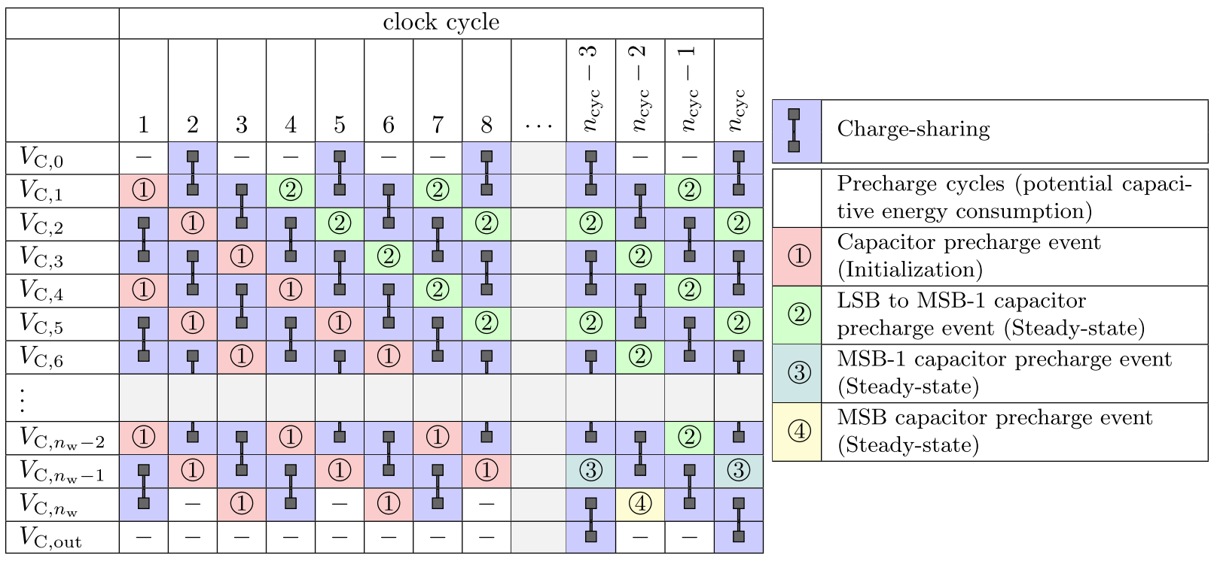
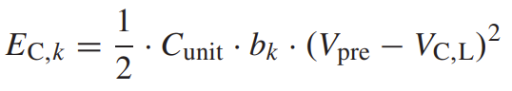
Energy consumption and Power

Slide 14
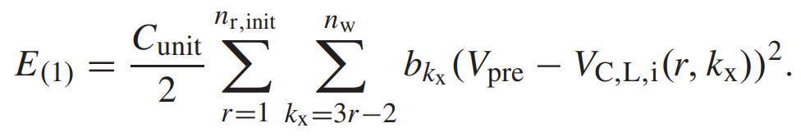
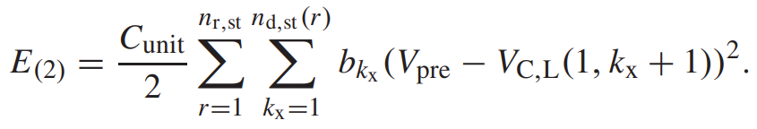
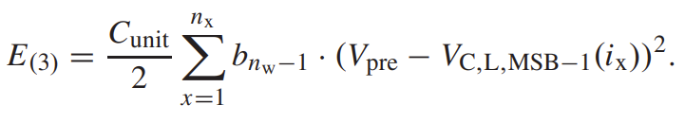
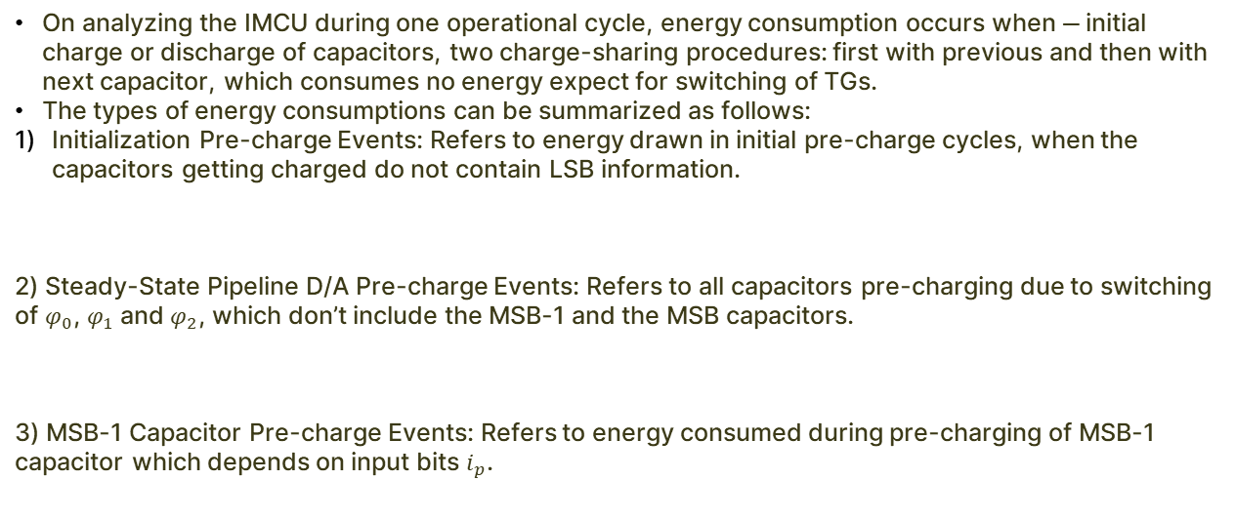
Energy consumption and Power
On analyzing the IMCU during one operational cycle, energy consumption occurs when ― initial charge or discharge of capacitors, two charge-sharing procedures: first with previous and then with next capacitor, which consumes no energy expect for switching of TGs.
The types of energy consumptions can be summarized as follows:
Initialization Pre-charge Events: Refers to energy drawn in initial pre-charge cycles, when the capacitors getting charged do not contain LSB information.
2) Steady-State Pipeline D/A Pre-charge Events: Refers to all capacitors pre-charging due to switching of $φ_{0}$, $φ_{1}$ and $φ_{2}$, which don’t include the MSB-1 and the MSB capacitors.
3) MSB-1 Capacitor Pre-charge Events: Refers to energy consumed during pre-charging of MSB-1 capacitor which depends on input bits $i_{p}$.

Slide 15
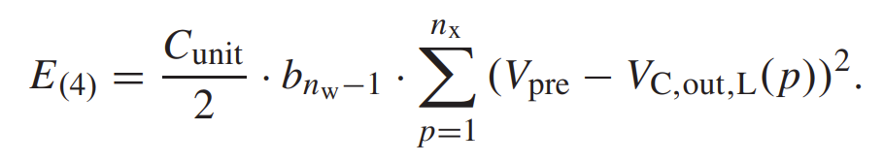
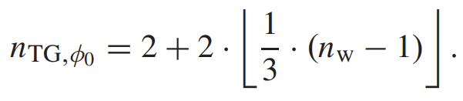
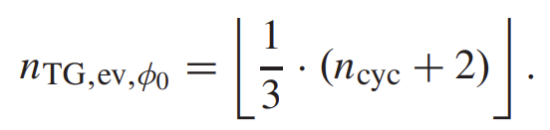
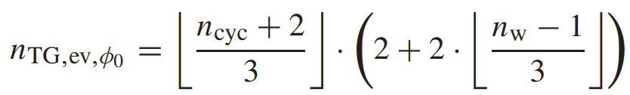
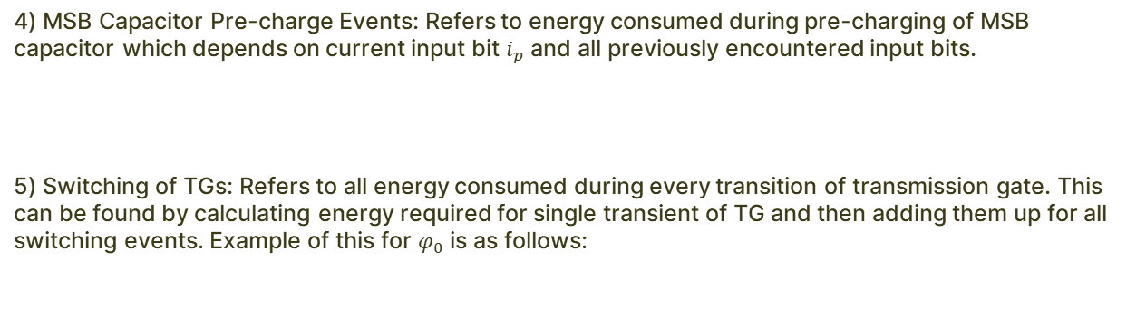
Energy consumption and Power
4) MSB Capacitor Pre-charge Events: Refers to energy consumed during pre-charging of MSB capacitor which depends on current input bit $i_{p}$ and all previously encountered input bits.
5) Switching of TGs: Refers to all energy consumed during every transition of transmission gate. This can be found by calculating energy required for single transient of TG and then adding them up for all switching events. Example of this for $φ_{0}$ is as follows:

Slide 16
3-Bit IMCU
Figure : Given circuit of a 3-bit signed IMCU

Slide 17
3-Bit IMCU

Slide 18
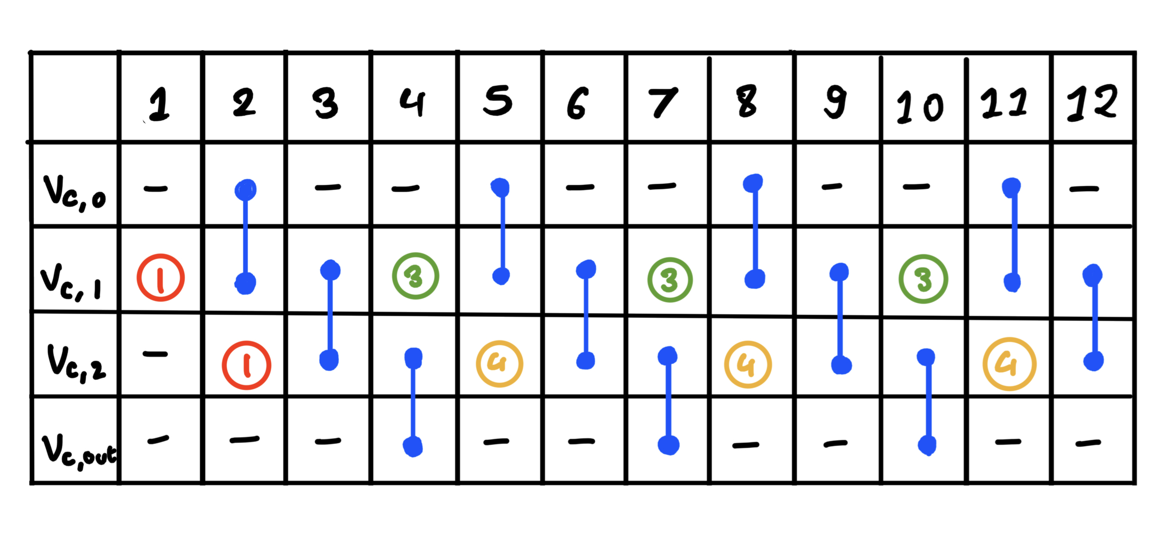
Energy consumption and Power

Slide 19
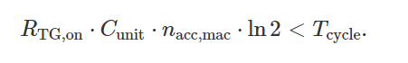
Noise and Non-linearity
Effect of R-TG : We make sure transmission gate R_{TG-ON} ’s effect is negligible by designing clock time period to ensure complete voltage settling.
Thermal noise
Manufacturing differences in capacitances.

Slide 20
03
Implementation

Slide 21
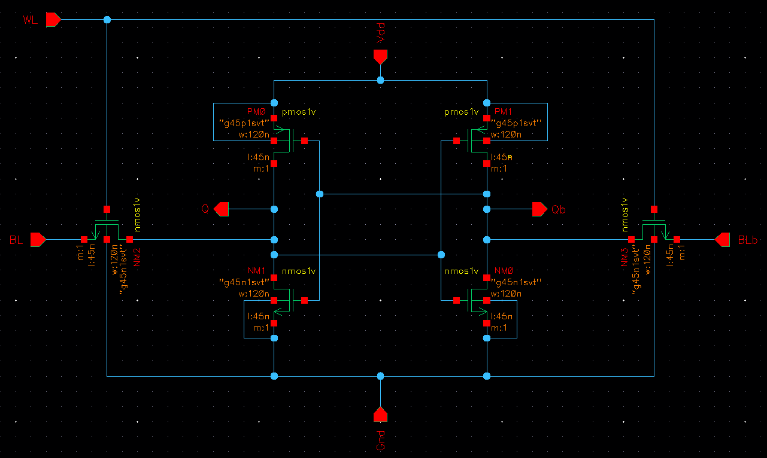
6T-SRAM Block
Figure 4: Circuit of a 6T-SRAM memory unit

Slide 22
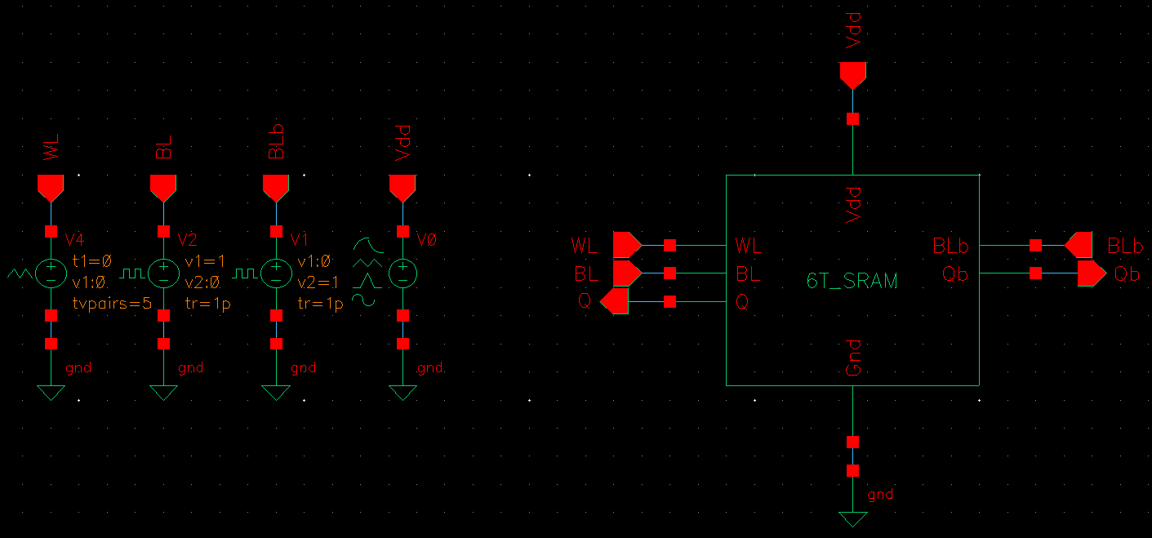
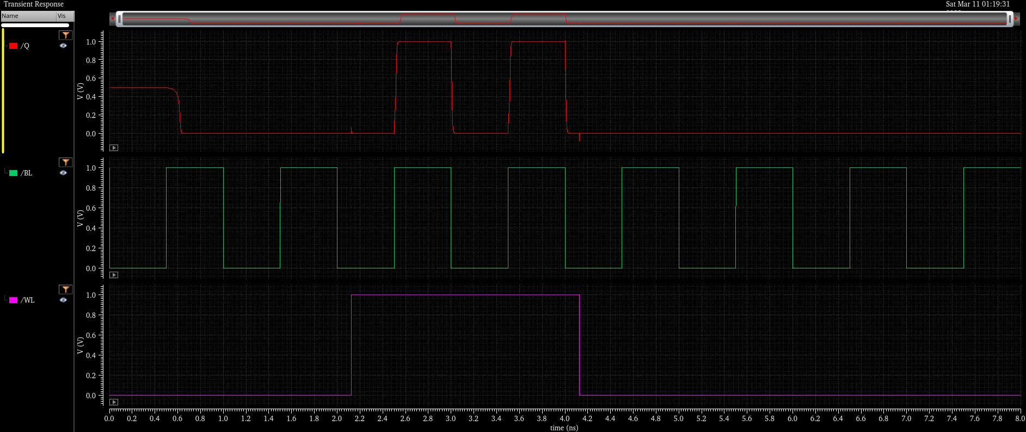
6T-SRAM Block
Figure 6: Graphs of inputs and outputs of SRAM test circuit
Figure 5: Test circuit for SRAM unit
This circuit was then tested by giving the a PWL input to the word line and a pulse input to the bit line.
The output given by the SRAM block is as expected as seen in the graphs above.
The output follows the bit line whenever word line is active and holds the bit line when the word line turns OFF

Slide 23
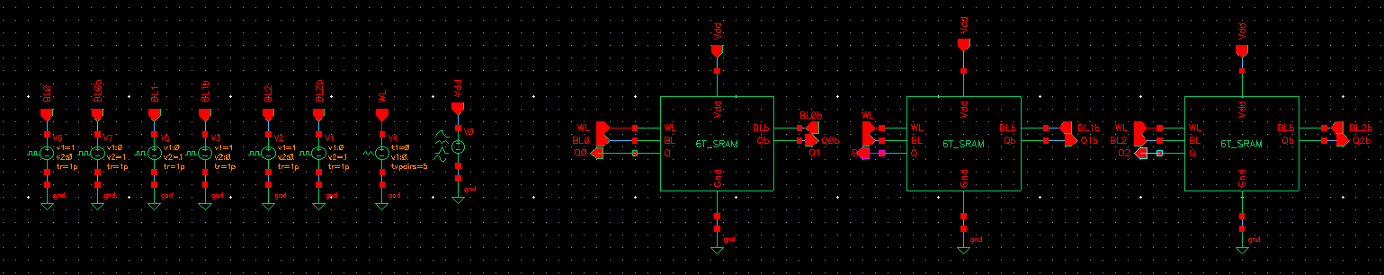
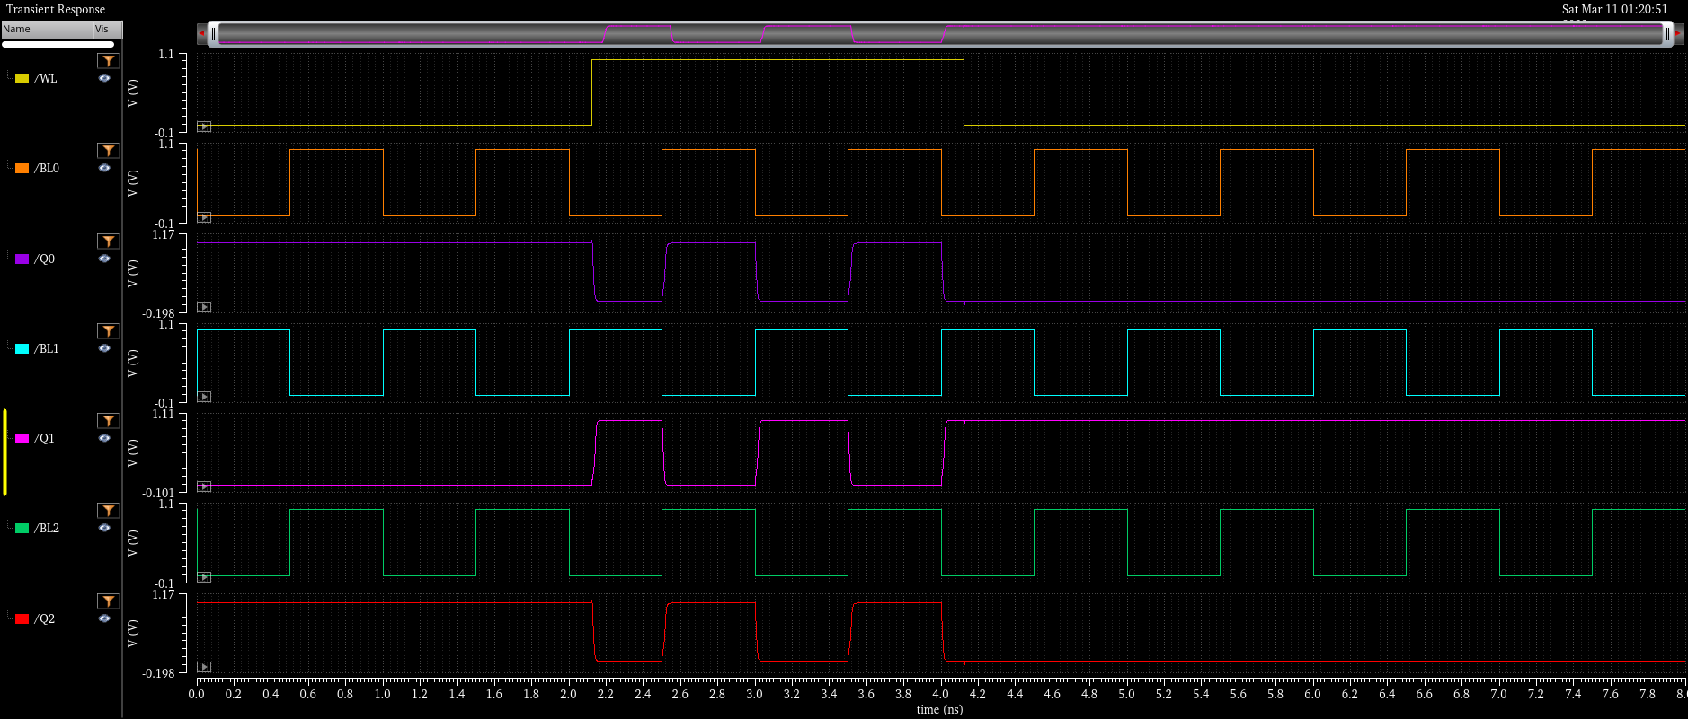
3-Bit SRAM Unit
3-Bit SRAM memory unit was made with 3 6T-SRAM blocks and the circuit and graphs obtained are as shown below:
Figure 7: Circuit for 3-bit SRAM memory unit
Figure 8: Graphs of inputs and outputs of 3-bit SRAM unit

Slide 24
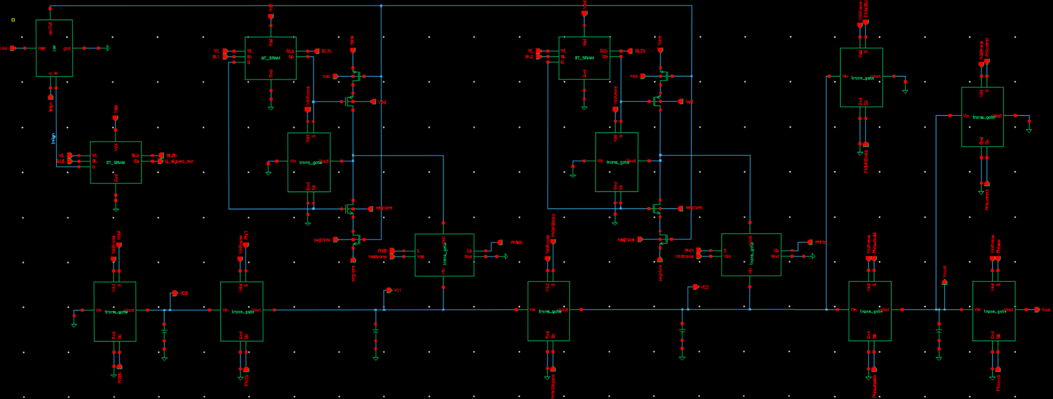
Implemented 3-Bit IMCU
Figure : 3-bit IMCU implemented on Cadence Virtuoso

Slide 25
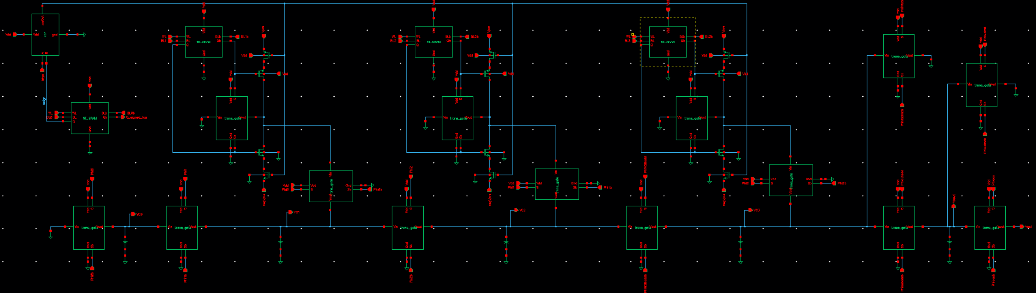
Extended to 4-bit and 5-bit
Figure : 4-bit IMCU implemented on Cadence Virtuoso

Slide 26
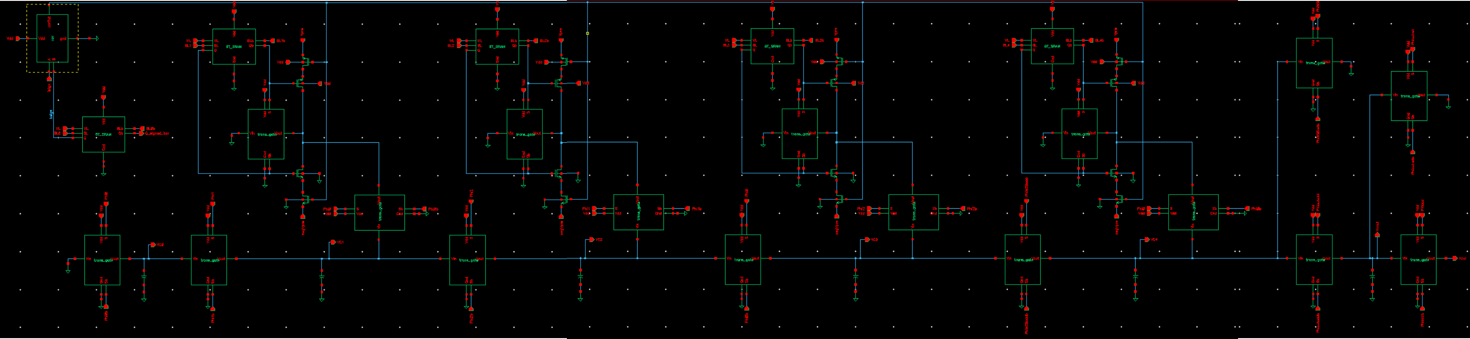
Extended to 4-bit and 5-bit
Figure : 5-bit IMCU implemented on Cadence Virtuoso

Slide 27
04
Results

Slide 28
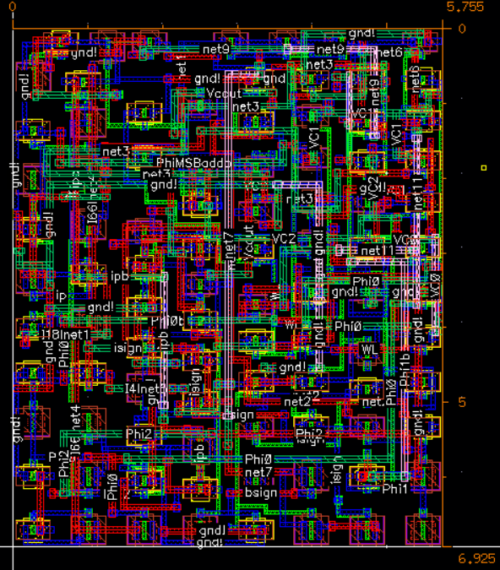
Layout of 3-Bit IMCU
Figure : Layout of 3-bit IMCU implemented on Cadence Virtuoso

Slide 29
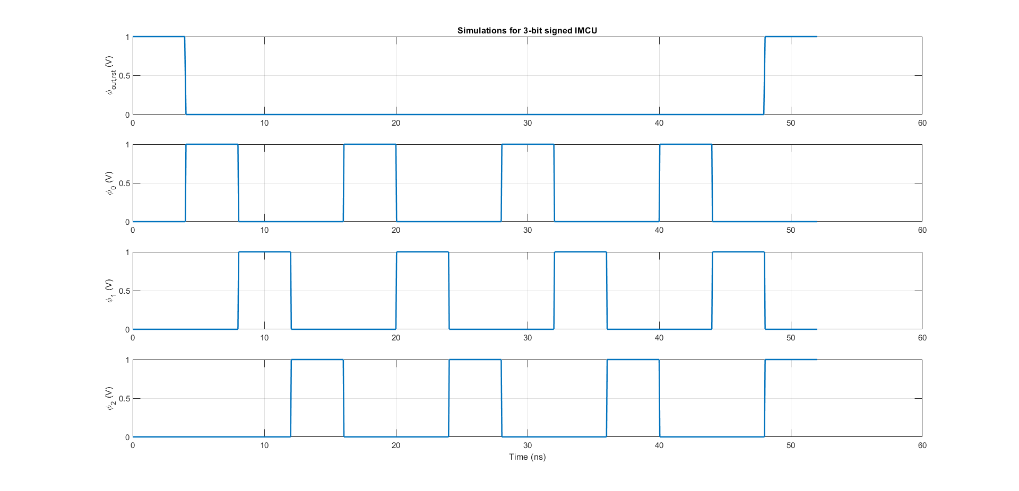
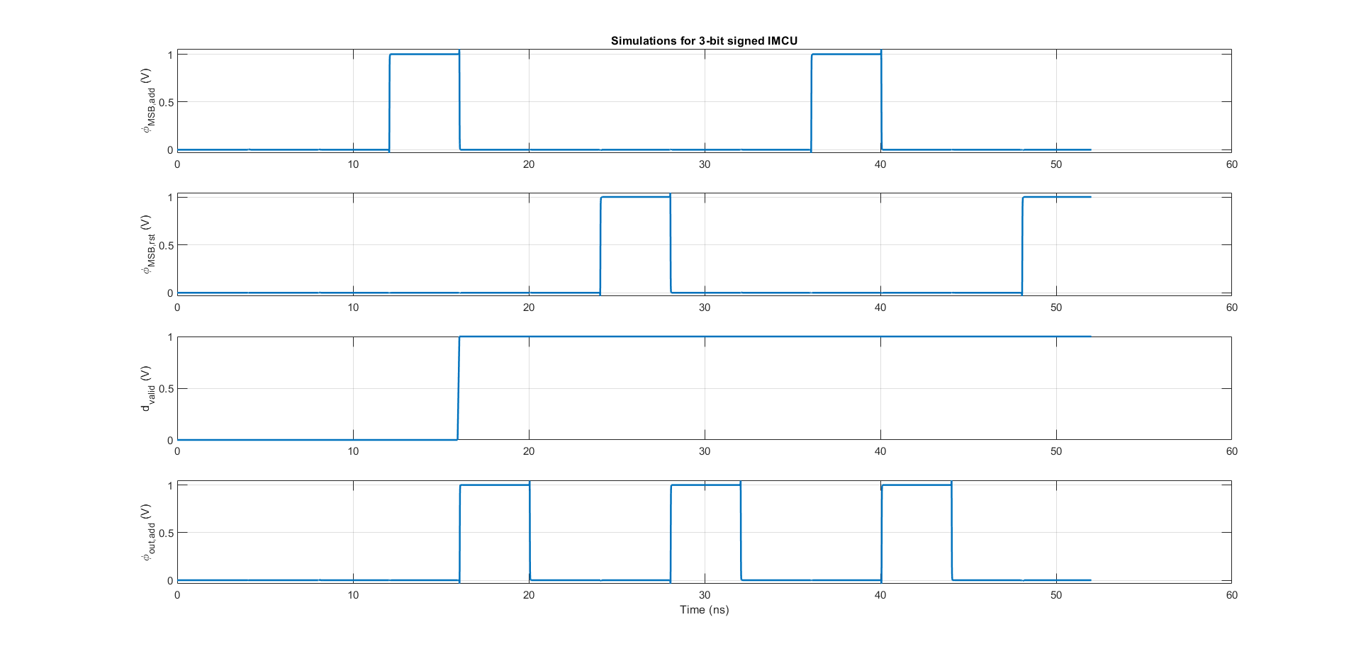
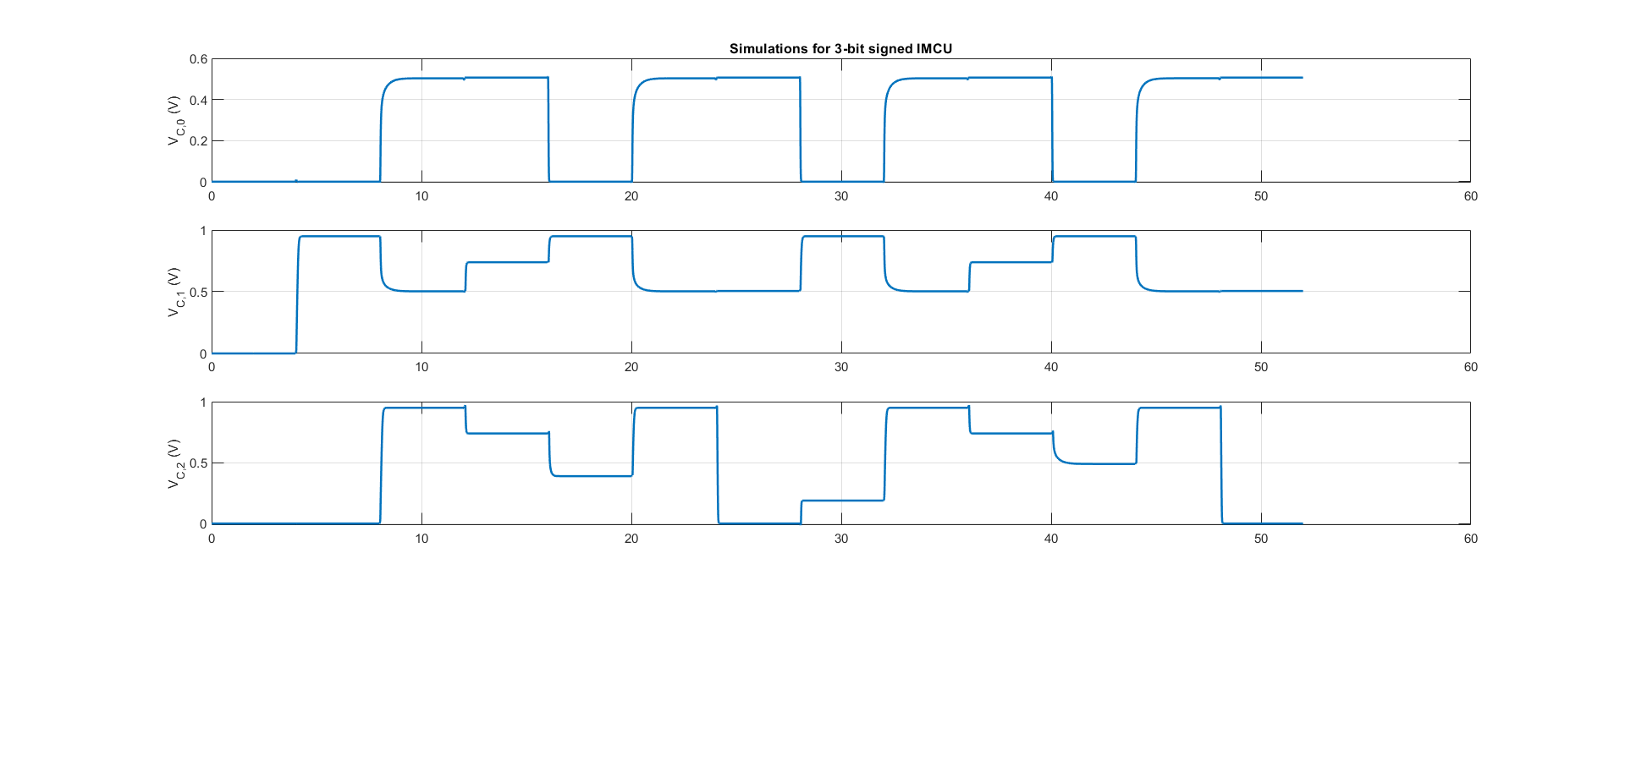
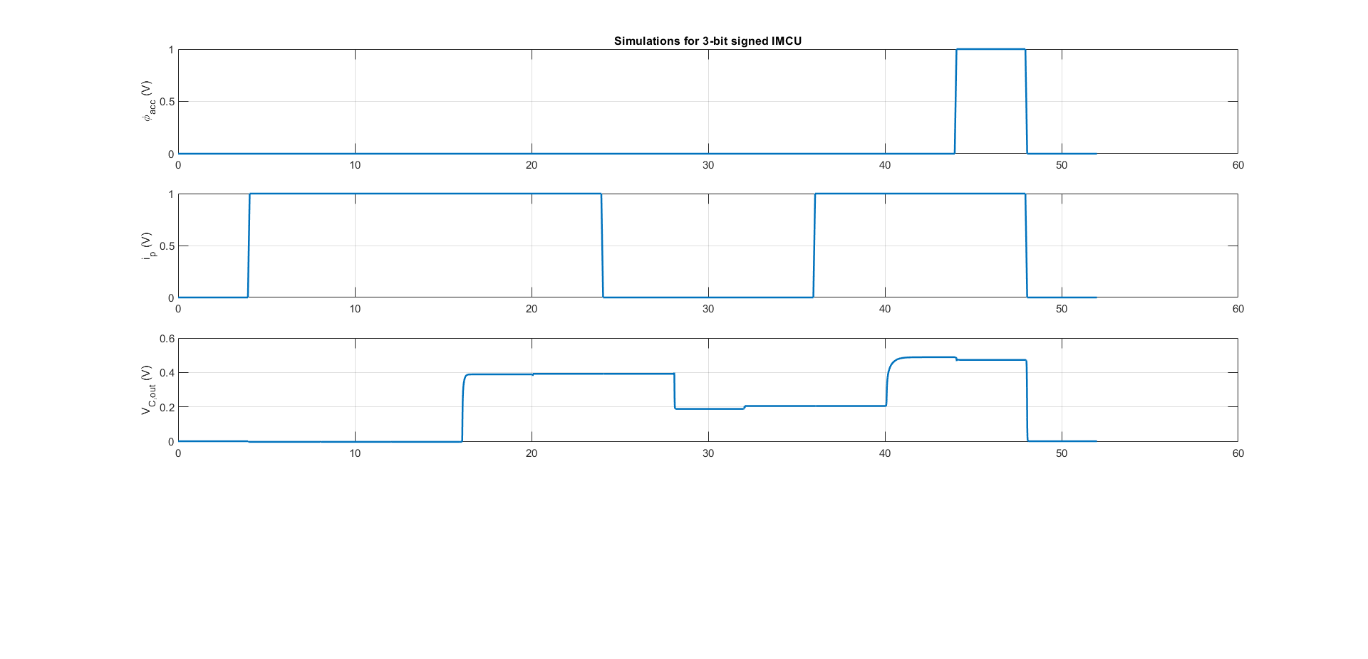
Graphs for 3-bit IMCU

Slide 30
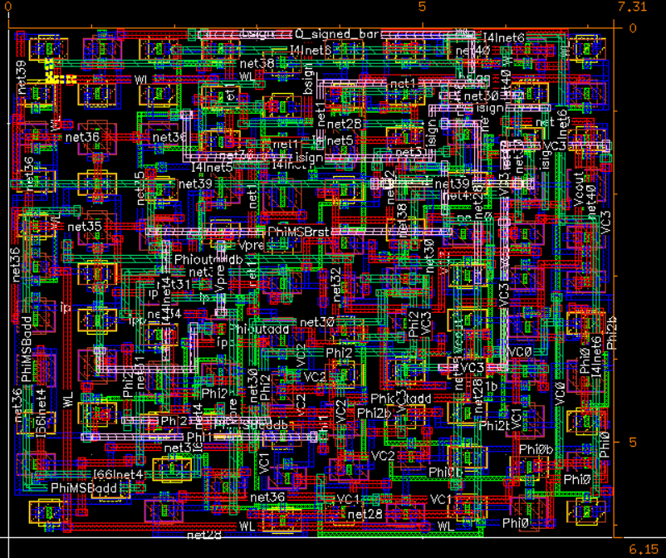
Layout of 4-Bit IMCU
Figure : Layout of 4-Bit IMCU implemented on Cadence Virtuoso

Slide 31
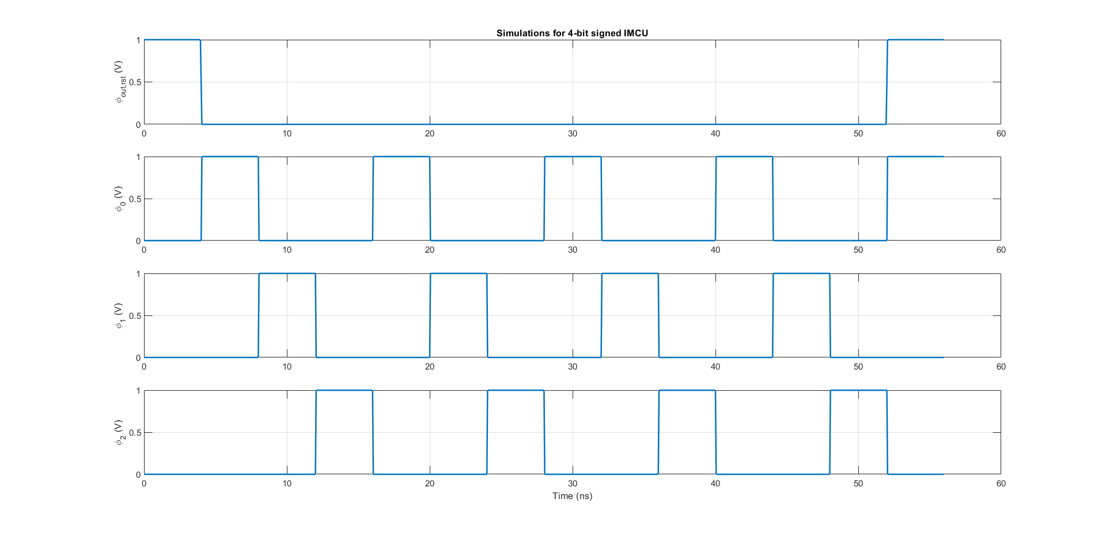
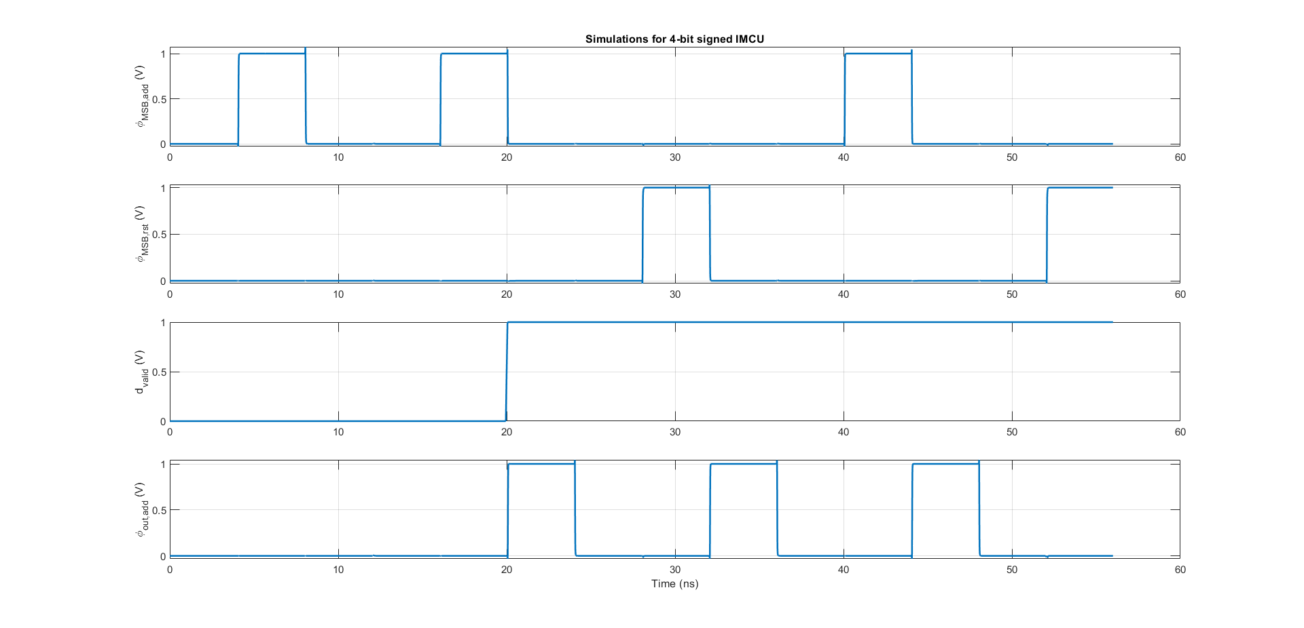
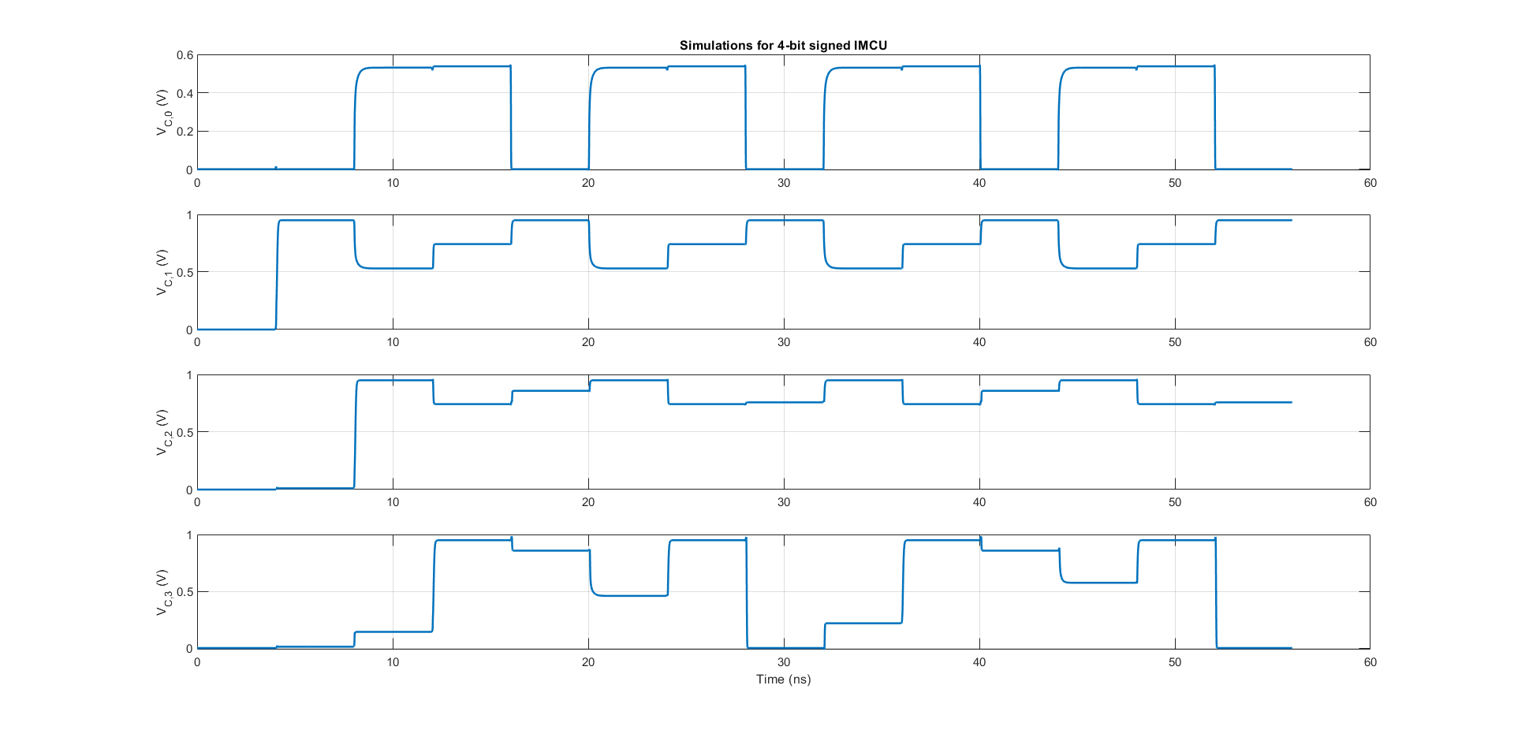
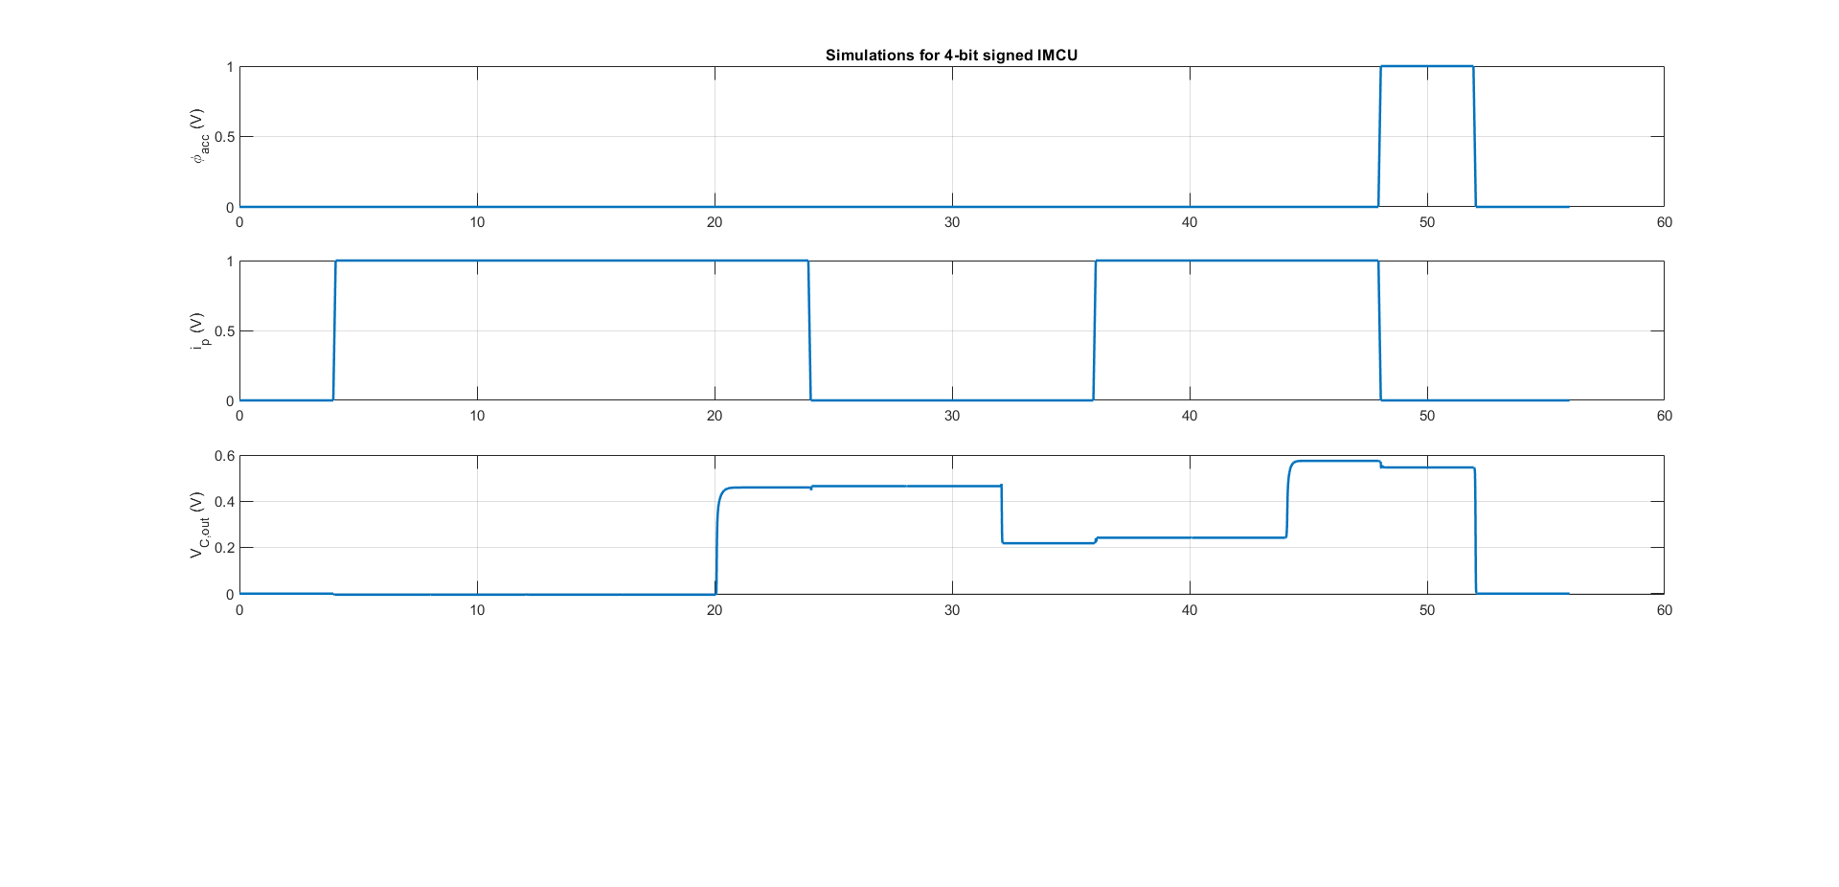
Graphs for 4-bit IMCU

Slide 32

Layout of 5-Bit IMCU
Figure : Layout of 5-Bit IMCU implemented on Cadence Virtuoso

Slide 33




Graphs for 5-bit IMCU

Slide 34

Final Results
Number of weight bits ($n_{w}$) | DELAY (I/P – O/P) | ENERGY ($fJ$) | LAYOUT
 |  |  | W x H | Area($μm^{2}$)
3-bit | 40 $ns$ | $$E_{IMCU,total}=E_{(1)}+E_{(2)}+E_{(3)}+E_{(4)}+E_{TG,total}$$ 30.342 = 4.483 + 3.392 + 0 + 5.683 + 16.784 | 5.755 x 6.925 | 39.853
4-bit | 44 $ns$ | $$E_{IMCU,total}=E_{(1)}+E_{(2)}+E_{(3)}+E_{(4)}+E_{TG,total}$$ 45.561 = 6.7 + 3.5134 + 1.6479 + 5.282 + 28.418 | 6.15 x 7.31 | 44.956
5-bit | 48 $ns$ | $$E_{IMCU,total}=E_{(1)}+E_{(2)}+E_{(3)}+E_{(4)}+E_{TG,total}$$ 61.066 = 10.138 + 3.4231 + 0.7511 + 5.22 + 41.534 | 6.13 x 8.445 | 51.767
The results in the above table show that the properties vary linearly with $n_{w}$.

Slide 35
05
Conclusions

Slide 36
Conclusions
The design implemented in this paper succeeds in obtaining linear increase in delay, energy and area with increase in number of bits.
This was also verified in the simulations performed on 3-bit, 4-bit and 5-bit IMCUs.

Slide 37
06
Future Work

Slide 38
Future Work
On simulating the circuit we found that for negative analog outputs, the widths for the PMOS and NMOS need to be varied, adjusting the strength of the pull-up and pull-down circuits. This issue can be resolved by using transmission gates in place of pass transistors at the cost of 4 additional transistors per bit.
The paper also performs a full system implementation of the proposed design using SRAM arrays, an ADC converter and a separate module for the IMCUs. We plan on doing this hardware implementation and try incorporating the earlier proposed change.

Slide 39
References
P. Athe and S. Dasgupta, "A comparative study of 6T, 8T and 9T decanano SRAM cell," in Proc. ISIEA, vol. 2, Oct. 2009, pp. 889-894. - Binder1.pdf (ijltet.org)
F.-J. Wang, G. C. Temes, and S. Law, “A quasi-passive CMOS pipeline D/A converter,” IEEE J. Solid-State Circuits, vol. 24, no. 6, pp. 1752–1755, Dec. 1989. - A quasi-passive CMOS pipeline D/A converter | IEEE Journals & Magazine | IEEE Xplore
E. H. Lee and S. S. Wong, “Analysis and design of a passive switchedcapacitor matrix multiplier for approximate computing,” IEEE J. SolidState Circuits, vol. 52, no. 1, pp. 261–271, Jan. 2017. - Analysis and Design of a Passive Switched-Capacitor Matrix Multiplier for Approximate Computing | IEEE Journals & Magazine | IEEE Xplore
L. Kull et al., “A 24-to-72gs/s 8b time-interleaved SAR ADC with 2.0-to-3.3pj/conversion and 30db SNDR at Nyquist in 14nm CMOS FinFET,” in IEEE Int. Solid-State Circuits Conf. (ISSCC) Dig. Tech. Papers, Feb. 2018, pp. 358–360. - A 24-72-GS/s 8-b Time-Interleaved SAR ADC With 2.0-3.3-pJ/Conversion and >30 dB SNDR at Nyquist in 14-nm CMOS FinFET | Request PDF (researchgate.net)

Slide 40
Q&A

